Slide 1
Hanyu Pinyin: A Brief History and Guide
By: Vivian Hir and Lumia Neyo
MIT Splash 2022

Slide 2
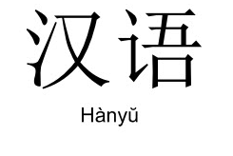
What is Hanyu Pinyin?
A romanization system used for Mandarin
Mandarin is standardized Chinese
Used in China and Singapore, Malaysia
Hong Kong and Taiwan does not use Hanyu Pinyin
In addition to Latin alphabet has four tones

Slide 3
Before Hanyu Pinyin
17th century: Jesuit missionaries attempt to romanize Chinese, not much success (catered for westerner)
19th century: Song Shu is inspired by Japan’s kana syllabaries, wants to adopt system in China
20th century: Wade Giles is used, gradually phased out

Slide 4
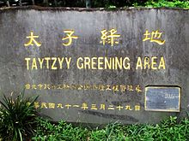
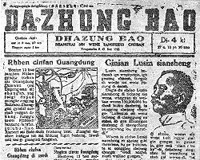
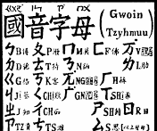
Origins of Hanyu Pinyin
Main founder was Zhou Youguang, a banker/economist
In 1930s, there was Gwoyeu Romatzyh and Latinxua Sin Wenz
Considered converting bopomofo into romanized form
Formalized in 1958, introduced to increase literacy rate
Use of pinyin outside China was a political statement

Slide 5
Why Learn Hanyu Pinyin
Efficient method to type Chinese on keyboard
You can use bopomofo, but more confusing
Can learn how to pronounce Chinese the proper way
Handy when you see a Chinese surname e.g. Xu, Cai, Qiu
Quick way to learn Chinese without knowing characters

Slide 6
Tongue Twisters

Slide 7
Four is Four, Forty is Forty
四是四。十是十，十四是十四，四十是四十，四十四是四十四
sì shì sì. shí shì shí, shí sì shì shí sì, sì shí shì sì shí, sì shí sì shì sì shí sì.
Four is four. Ten is ten, Fourteen is fourteen. Forty is forty, forty-four is forty-four.

Slide 8
Mom and Horse
妈妈骑马，马慢，妈妈骂马。
mā mā qí mǎ, mǎ màn, mā mā mà mǎ
Mom rides a horse, horse is slow, mom scolds the horse.

Slide 9
Grapes
吃 葡 萄 不 吐 葡 萄 皮 ,不 吃 葡 萄 倒 吐 葡 萄 皮
chī pú táo bù tǔ pú táo pí, bù chī pú táo dào tǔ pú táo pí
Eat a grape but you don't spit out the grape skin, don't eat a grape but spit out a grape skin.

Slide 10
Knowing and Not Knowing
知道就说知道, 不知道就说不知道, 不要知道说不知道, 也不要不知道说知道, 你知道不知道？
zhī dào jiù shuō zhī dào, bù zhī dào jiù shuō bu zhī dào. bú yào zhī dào shuō bu zhī dào, yě bú yào bù zhī dào shuō zhī dào, nǐ zhīdào bù zhīdào?
If you know say you know, if you don’t know say you don’t know. Don’t say you don’t know when you know, and don’t say you don’t know when you do know. Do you understand?

